Slide 1


Trash Track
Ravneet Kaur

Slide 2
Problem Statement :
Urbanization and population growth raise concerns about waste management efficiency.
Traditional waste management faces challenges in tracking, optimizing collection, and minimizing environmental impact.
Existing waste management processes are inefficient and prone to errors.
Manual tracking and coordination result in delays and resource consumption.
Sewerage blockage.
Foul smell if ineffectively managed.

Slide 3
Solution:
Real time monitoring: Implement real-time monitoring of waste bin levels.
Provide accurate data on fill status.
Alerts and Notifications: Integrate alerting mechanisms for timely notifications.
Prevent overflows and optimize collection schedules.
• User-Friendly Interface: Facilitate viewing and contributing to waste tracking data.
• Environmental Impact: Minimizing bad impact on environment by timely disposal.

Slide 4
Benefits :
Prevent infection/Diseases spread by garbage
Help to keep city clean
Proper disposal of waste
Ex. Farming waste for fertilizer and energy generation
Construction waste for reuse , dumping etc
It will help to provide knowledge on waste management

Slide 5
Technology used:
Software:
Arduino IDE: For code logic
MQTT (Broker): For communication between devices
MQTTAnalyzer (App): For receiving notification on mobile
Hardware:
Esp 32: For real-time sensing
Ultrasonic sensor: For measuring filled level
Others:
Wi-fi: For communication
Dustbin: For attaching sensor

Slide 6
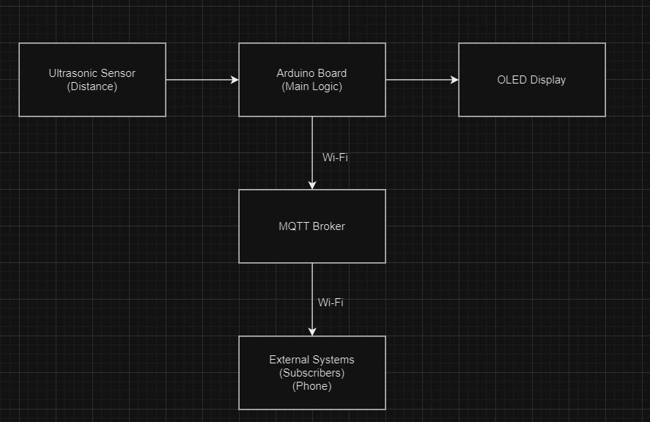
Architecture:

Slide 7
Working:

Slide 8
Future Developments:
Predictive Analytics:
Implement machine learning algorithms to analyze historical data and predict future fill levels. This enables forecasting, helping optimize waste collection schedules.
Integration with Weather Data:
Integrate weather data into the analysis to account for external factors influencing waste generation. This can improve the accuracy of predictions and optimize collection schedules based on weather patterns.
Energy Harvesting:
Explore energy harvesting solutions to power sensor nodes. This could involve incorporating solar panels or other renewable energy sources to reduce reliance on traditional power sources.

Slide 9
Thank you

